Slide 1
PREAMBLE & FUNDAMENTAL RIGHTS
Sagnik Biswas
BWU/BCS/18/004
B.Sc (CS)

Slide 2
INTRODUCTION
The Father Of Indian Constitution Is B.R. Ambedkar (Chairman).
Apart From Him There Were 7 Members To The Constitution Drafting Committee.
The Constitution As Drafted By The Committee Was Circulated On 21 February 1948.

Slide 3
WHAT IS PREAMBLE ?
A statement at the beginning of a speech or a writing, giving it's reason and purpose.
EQUALITY of status and of opportunity, and to promote among them all, FRATERNITY assuring the dignity of the individual and the unity and integrity of the Nation

Slide 4
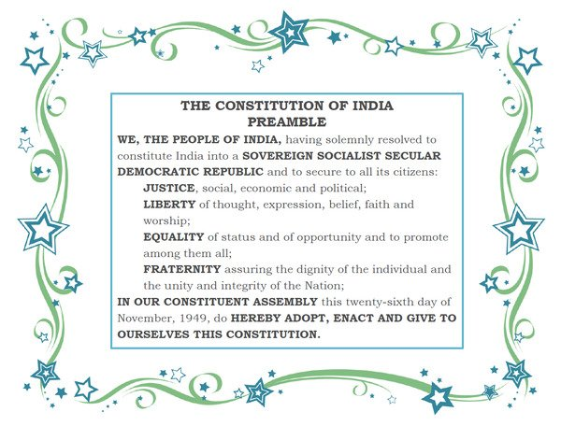

Slide 5
INNER MEANING
India is a republican polity people shall elect their government means absolute independence.
A govt. that will never be controlled by any other power.
India is not religious nor irreligious or anti-religious.

Slide 6
FUNDAMENTAL RIGHTS
literally rights means those freedom which are essential for personal good as well as the good of a community.
the 6 fundamental rights are-
rights to equality.
rights to freedom.
rights to freedom of religion.
cultural & educational rights.
rights to move to the court.

Slide 7
Thank You

